Slide 1

E-commerce
Team Members,
AAKASH S
DINESH KUMAR S
ANTONYPRASATH S
CHITRA S

Slide 2

iNTROduction
E-commerce (electronic commerce) is the buying and selling of goods and services, or the transmitting of funds or data, over an electronic network, primarily the internet.
These business transactions occur either as business-to-business (B2B), business-to-consumer (B2C), consumer-to-consumer or consumer-to-business.
The term e-tail is also sometimes used in reference to the transactional processes that make up online retail shopping.

Slide 3
Modules
ADMIN
CUSTOMER
PRODUCT
CART
PAYMENT

Slide 4
SOFTWARE REQUIREMENTS
FRONTEND
VS CODE (IDE)
ANGULAR 6
BOOTSTRAP
NODEJS
HTML5, CSS
TYPESCRIPT
BACKEND
REST API
SPRING BOOT
HIBERNATE AND JPA
DATABASE
MYSQL

Slide 5
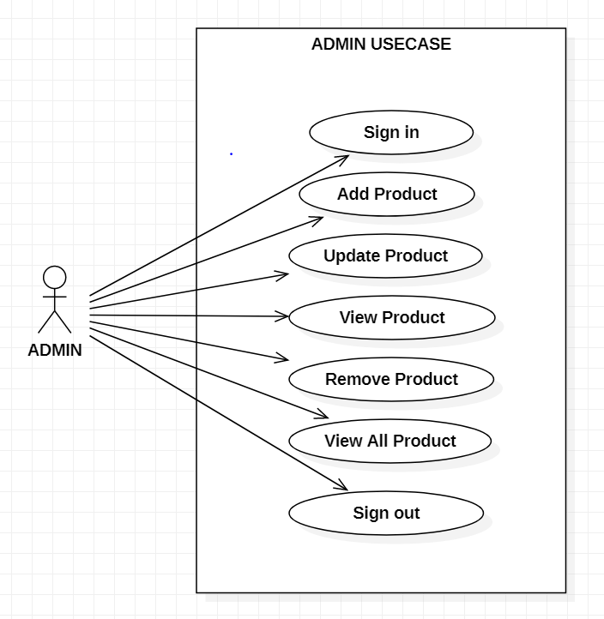
UML DIAGRAM
(ADMIN)

Slide 6
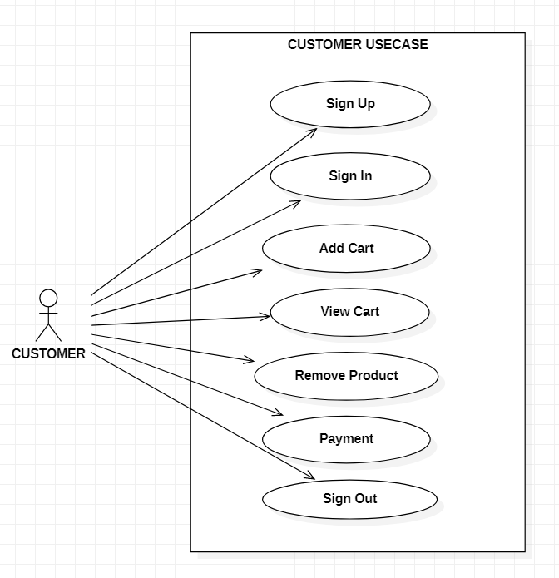
CUSTOMER

Slide 7
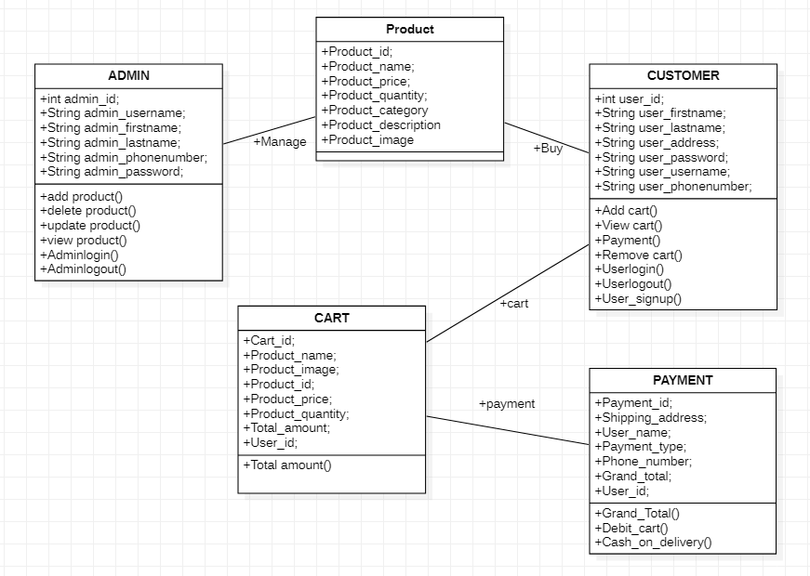
Class diagram

Slide 8
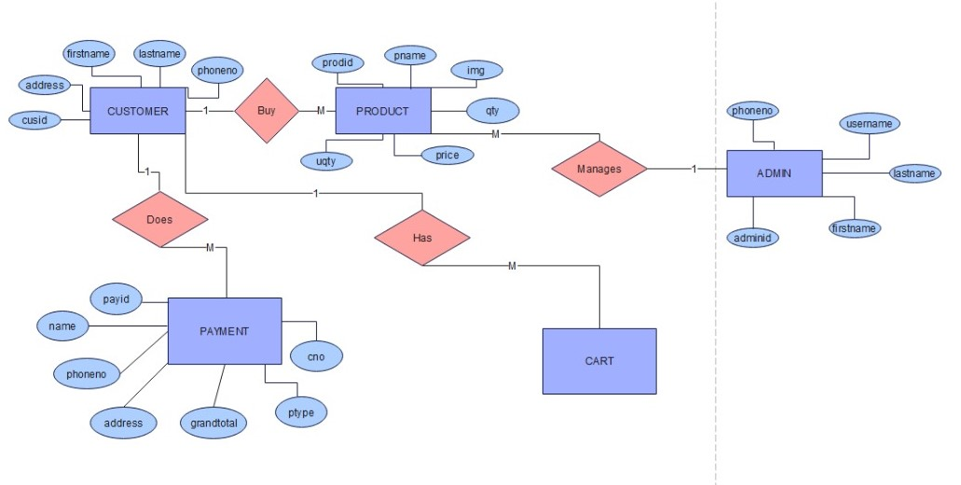
Er diagram

Slide 9
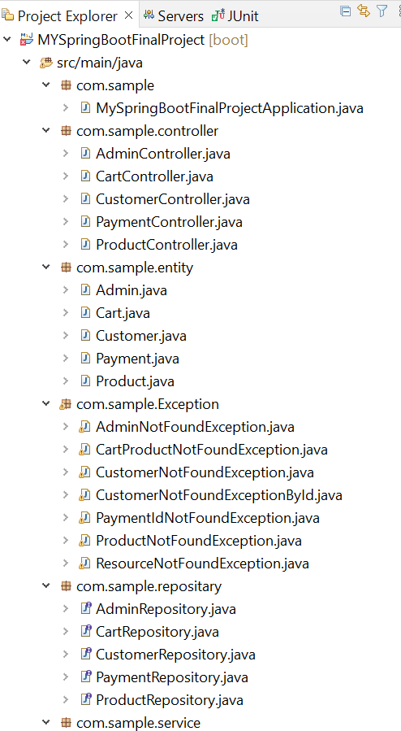
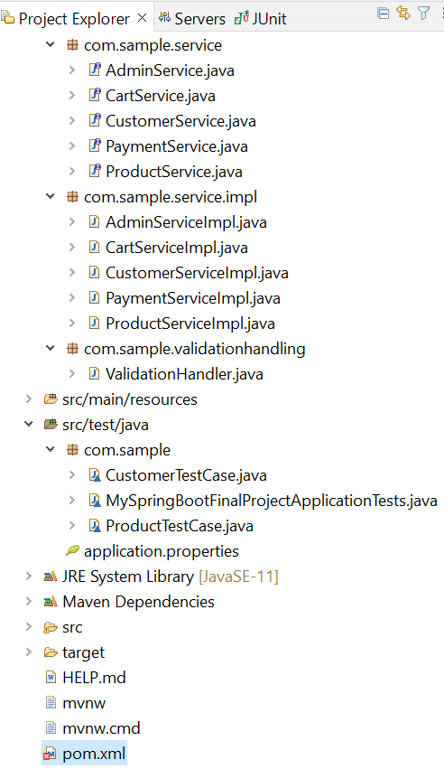
FOLDER STRUCTURE
BACKEND

Slide 10
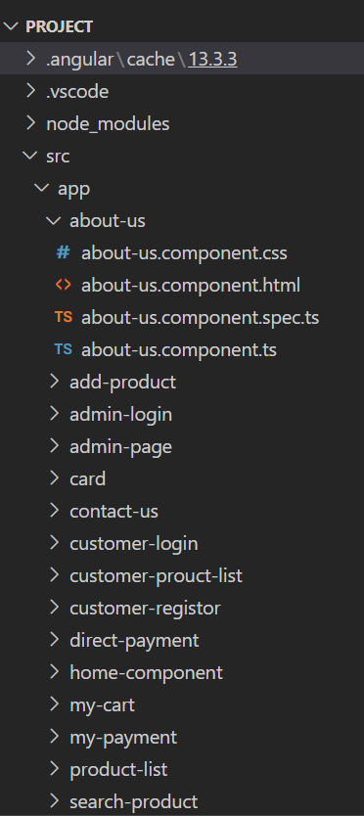
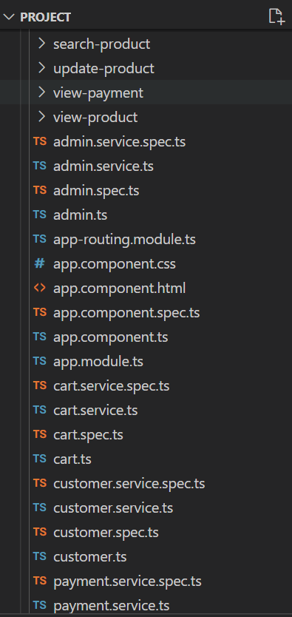
Folder Structure
FRONTEND

Slide 11
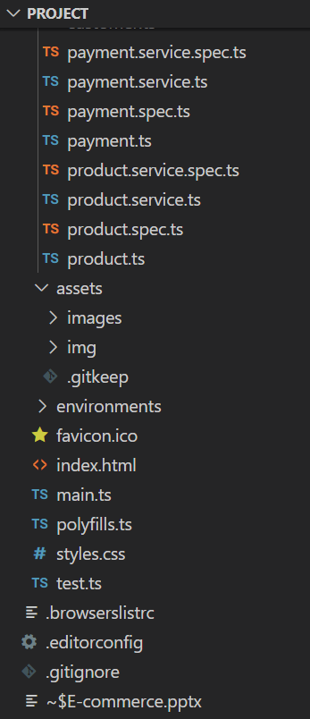
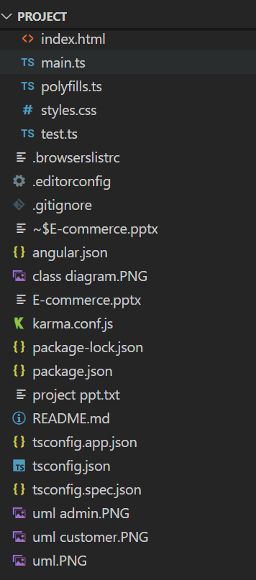

Slide 12
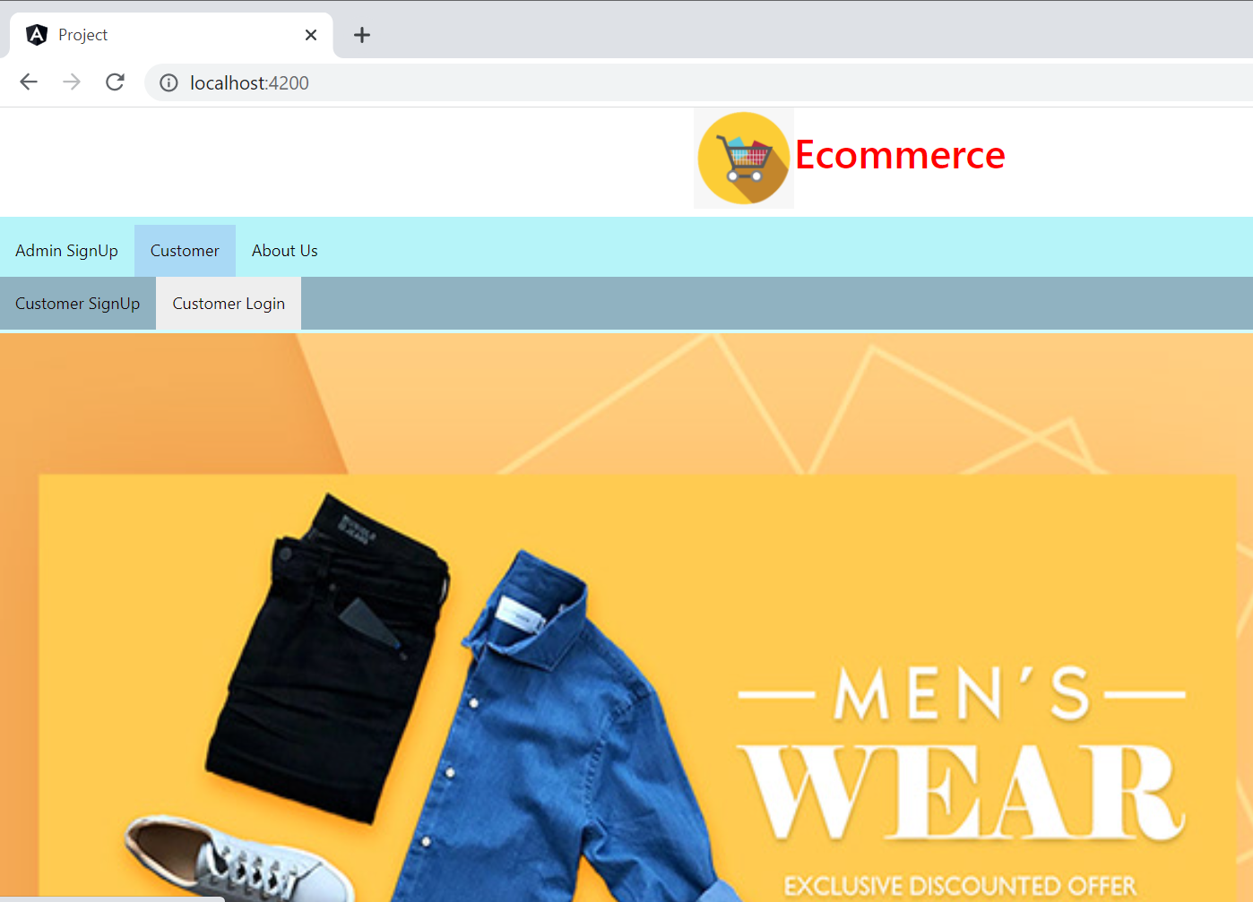
INDEX PAGE

Slide 13
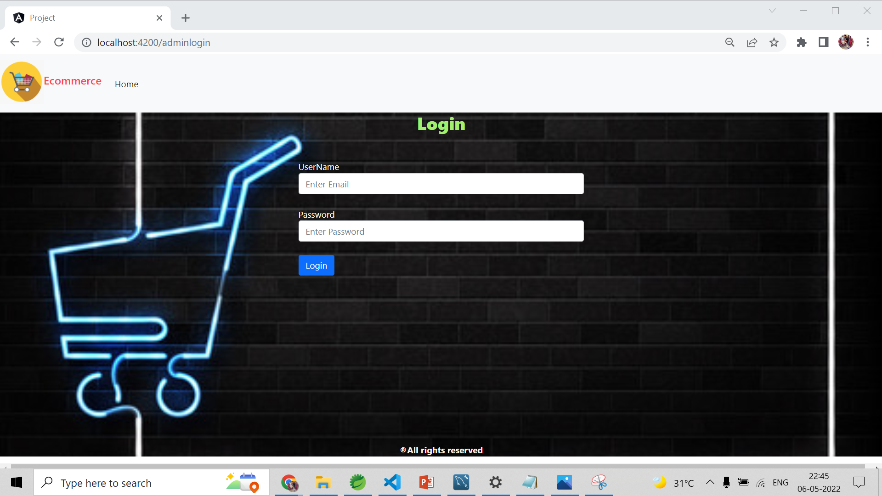
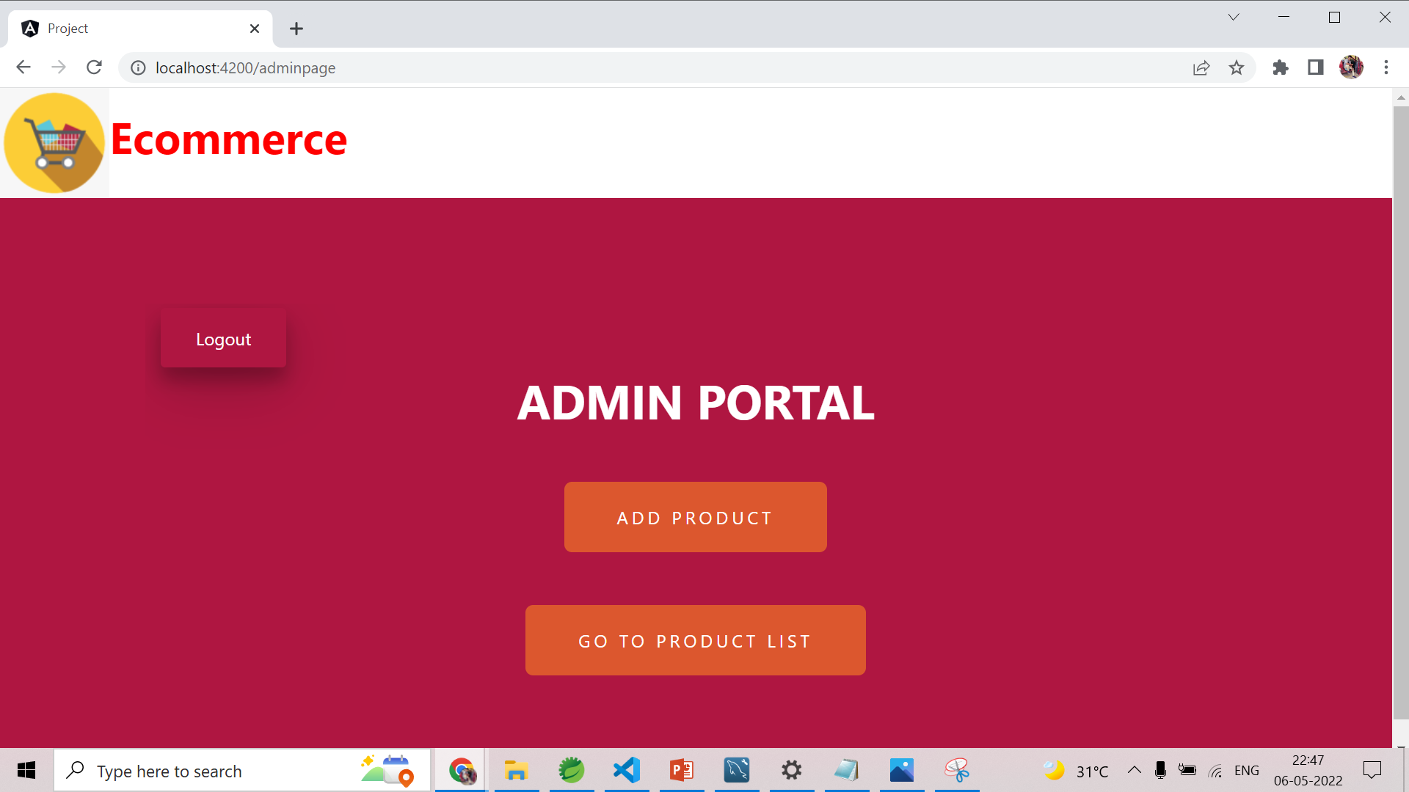
ADMIN

Slide 14
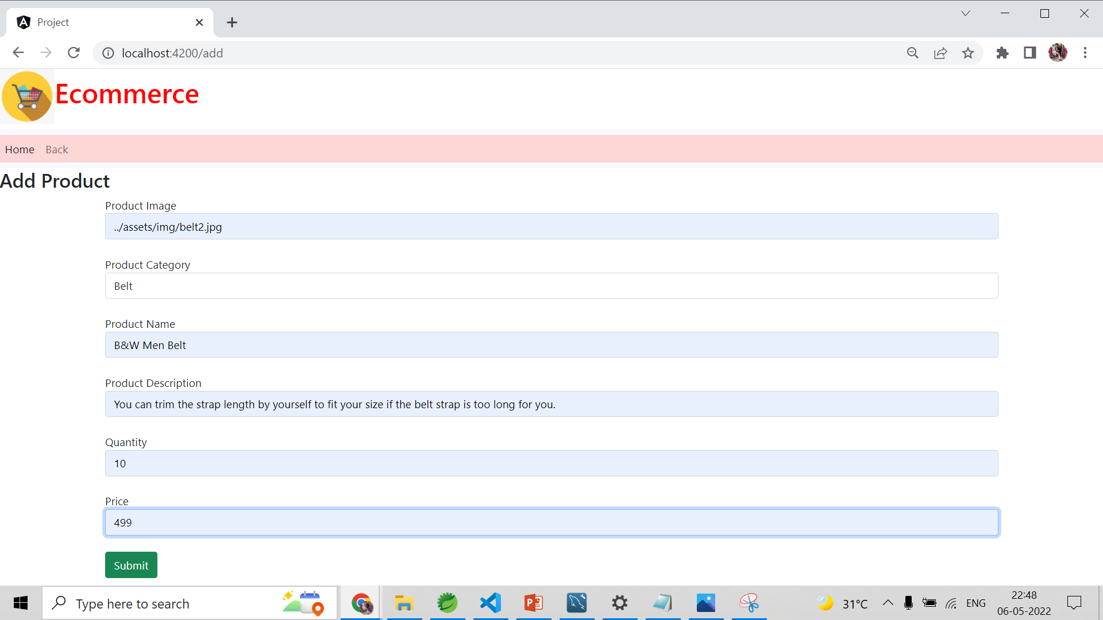
ADD PRODUCT

Slide 15
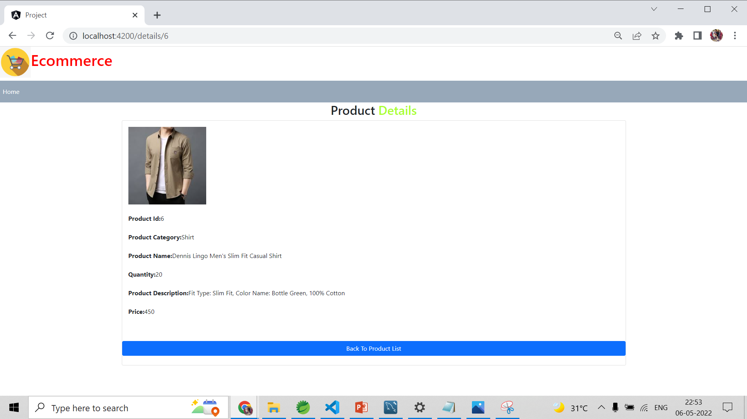
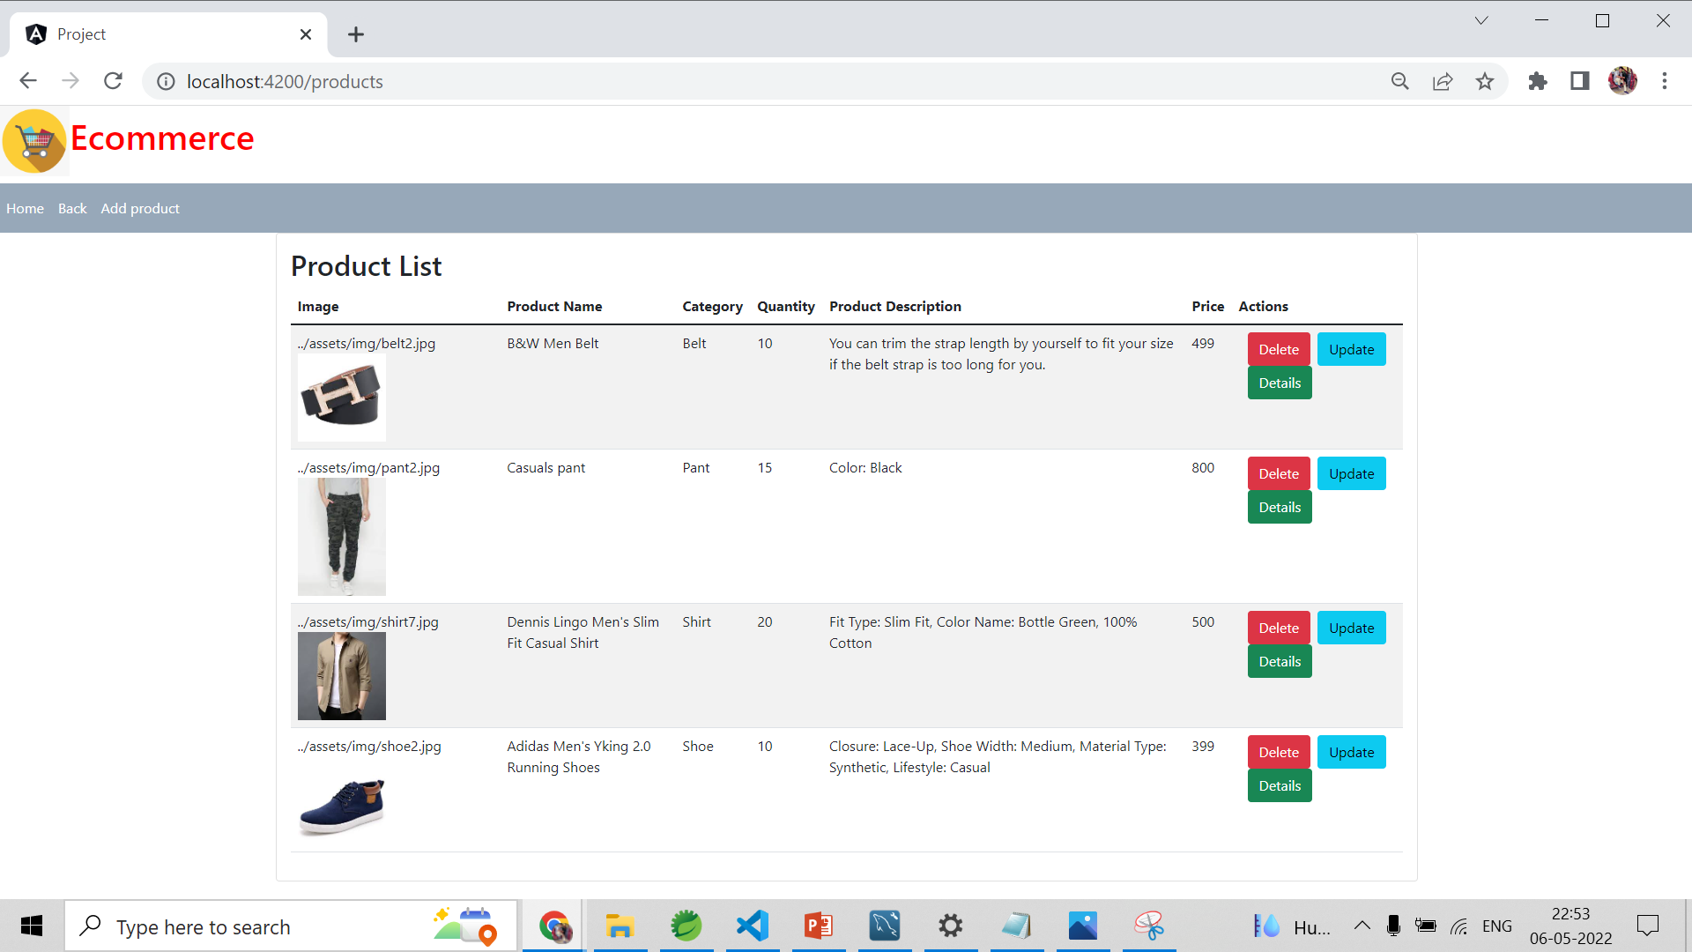
VIEW PRODUCT

Slide 16
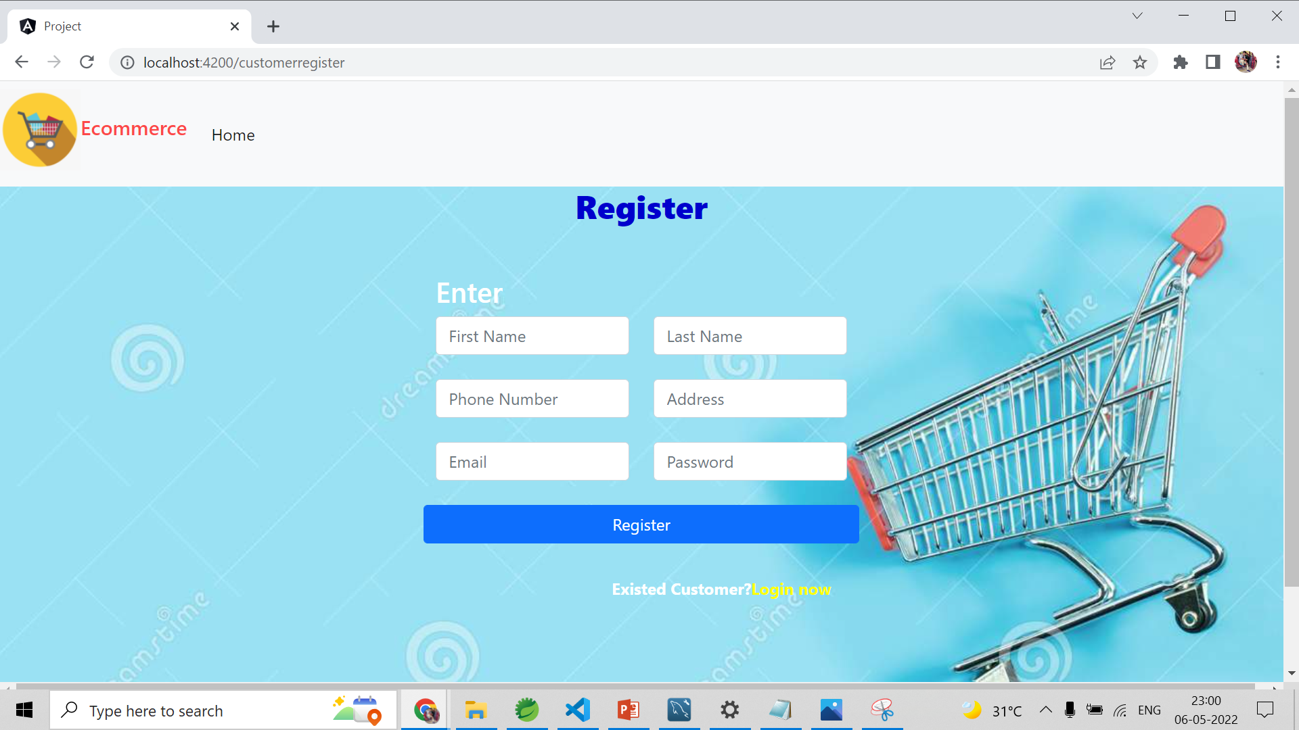
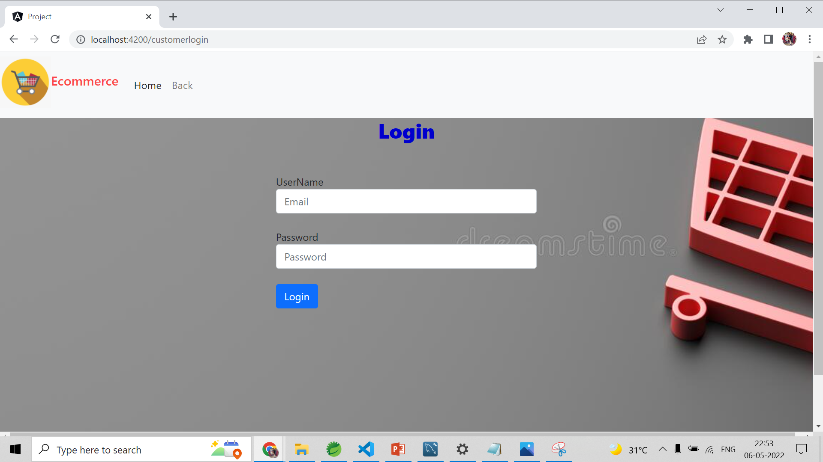
CUSTOMER

Slide 17
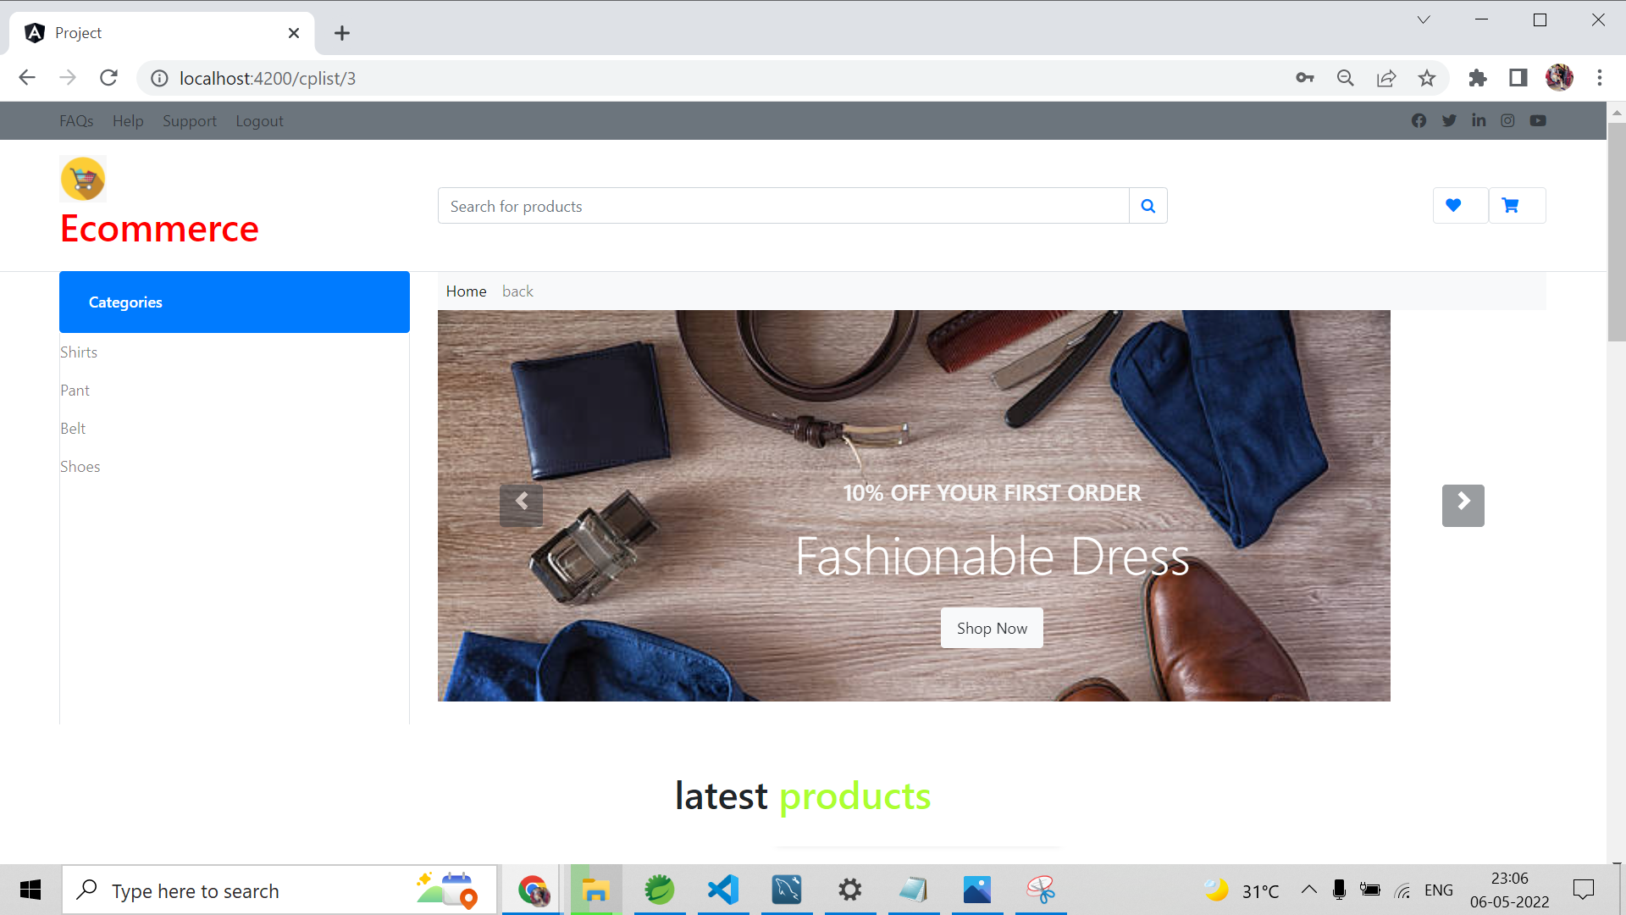
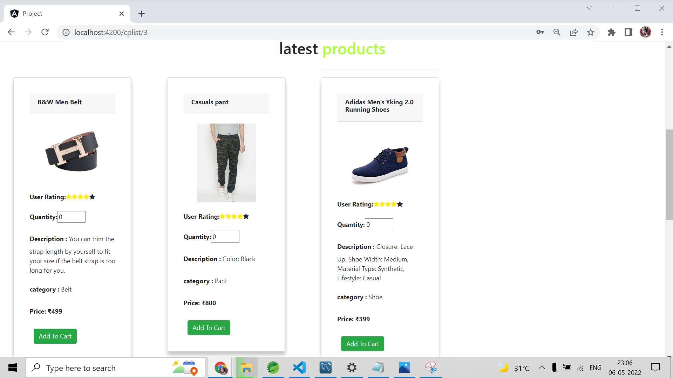
CUSTOMER HOME PAGE

Slide 18
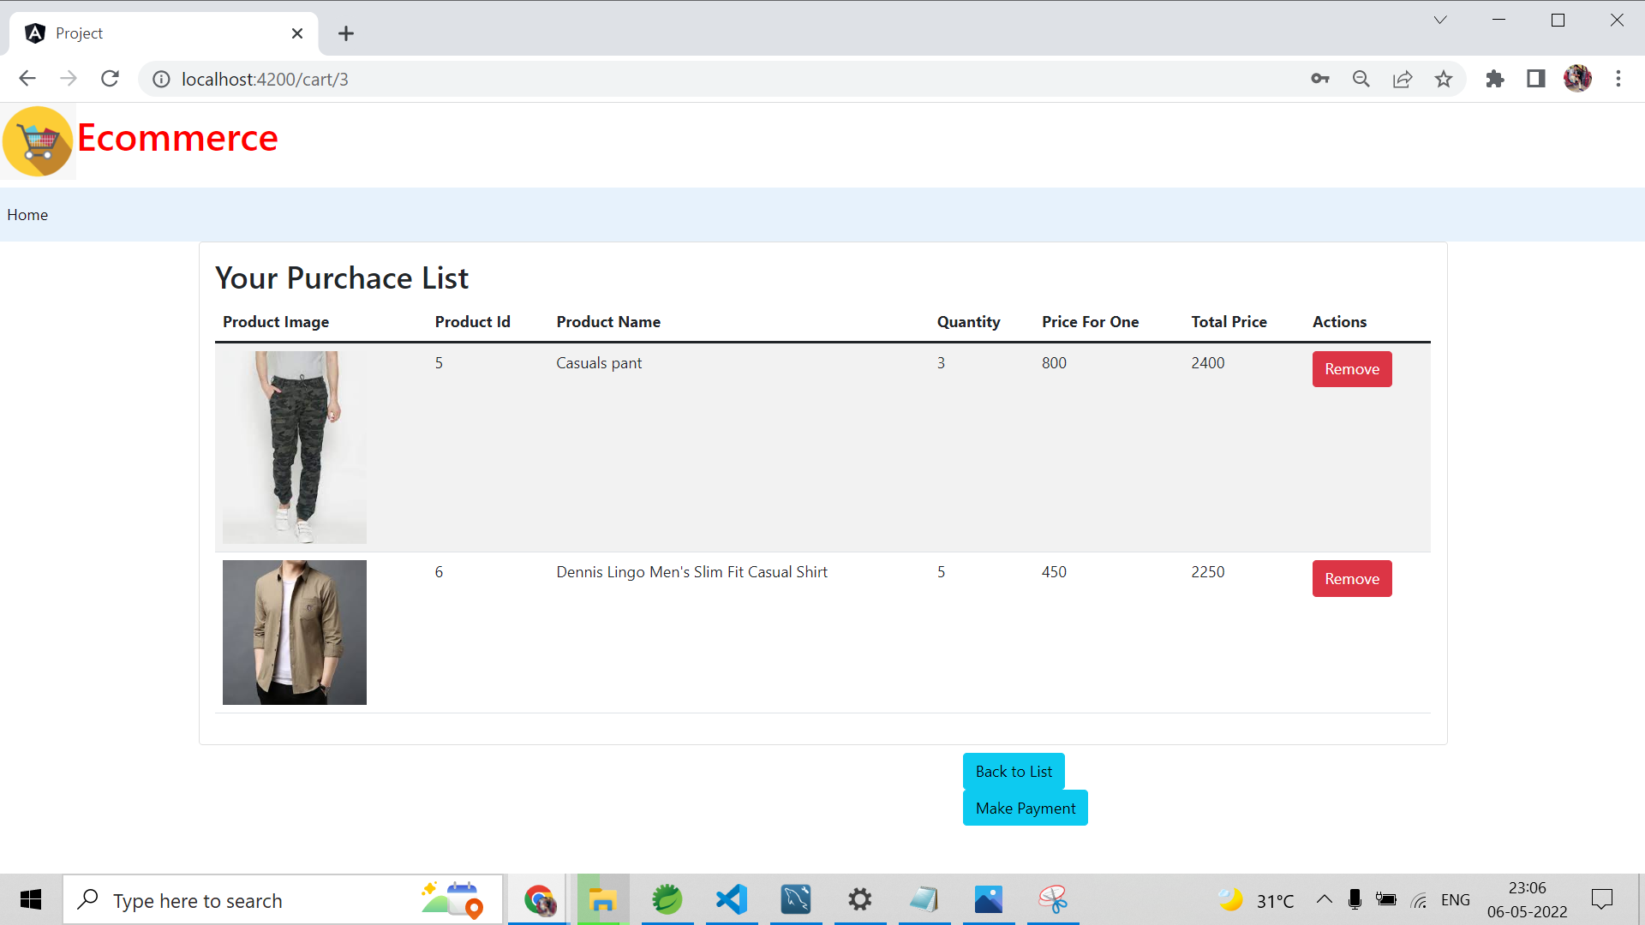
CART

Slide 19
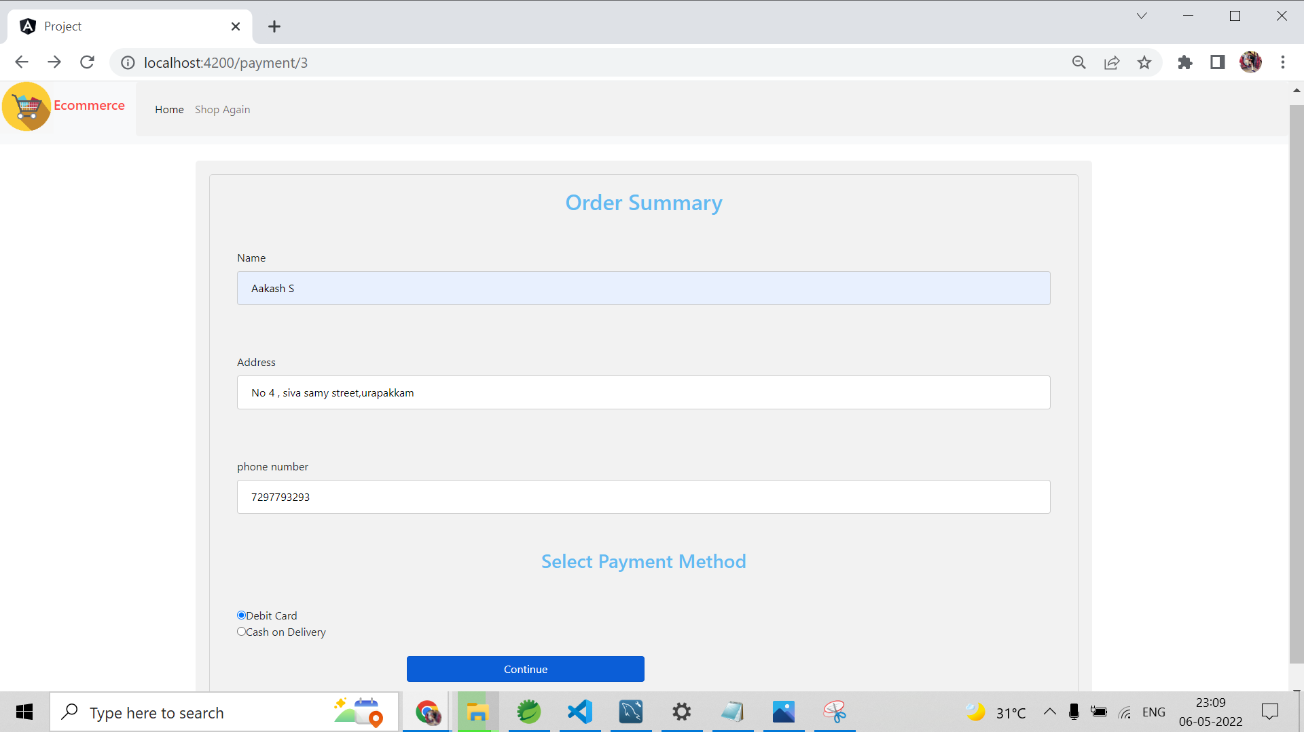
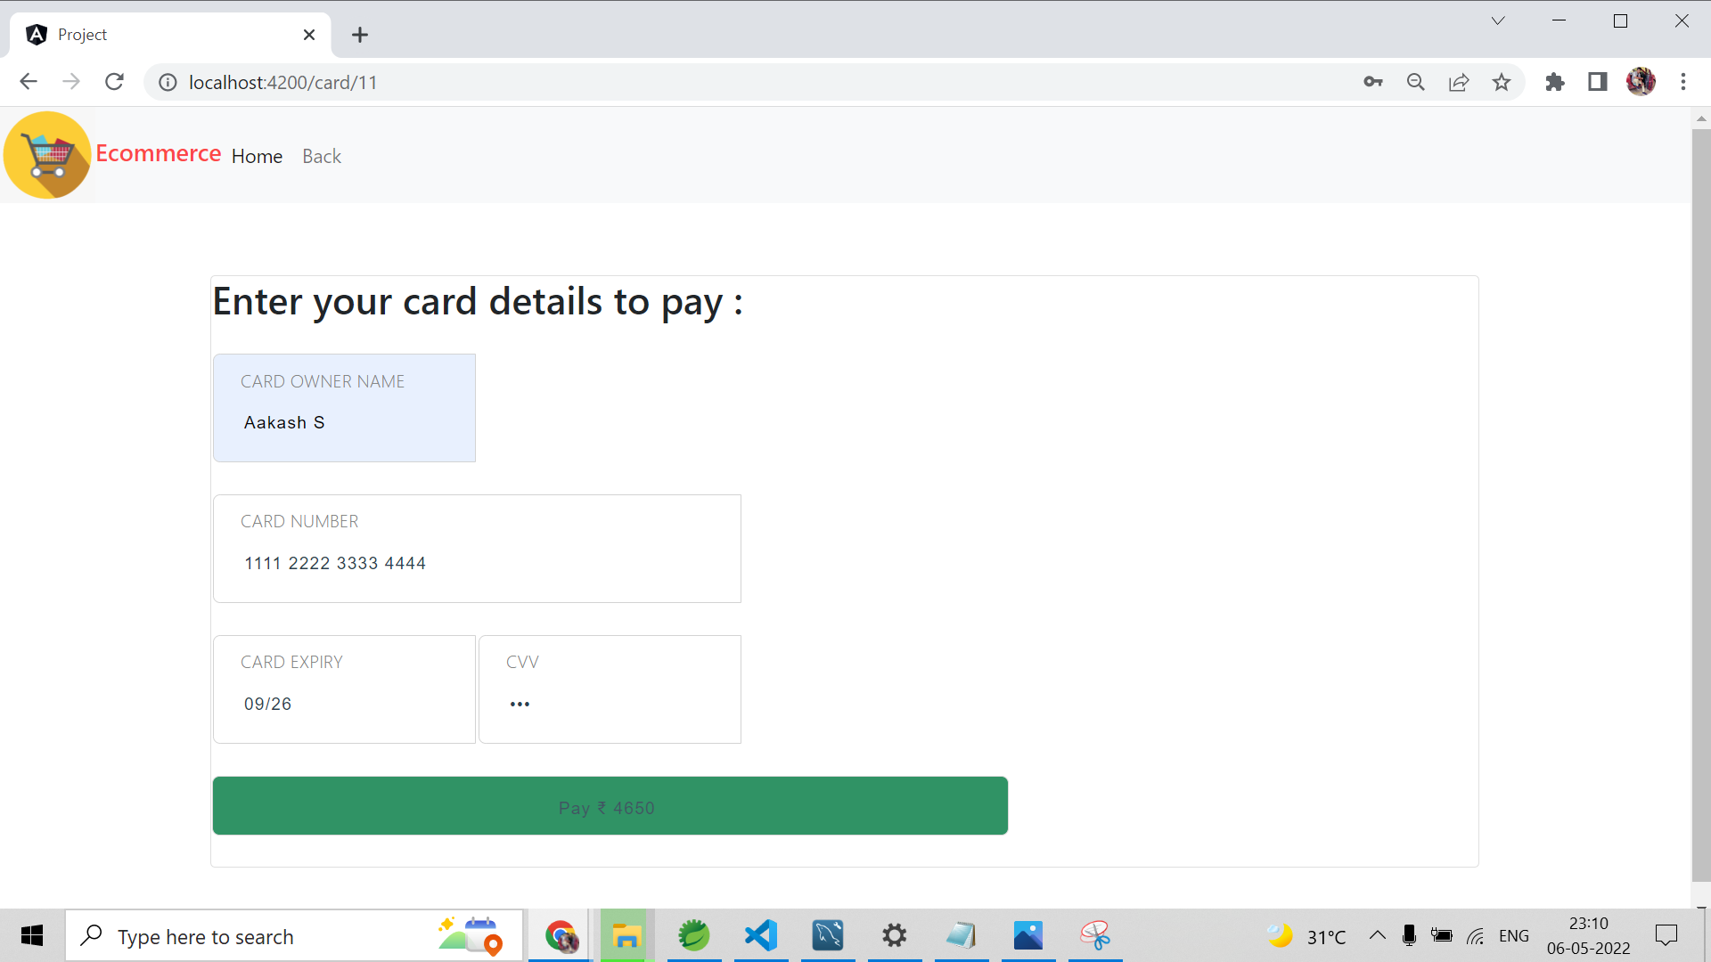
PAYMENT

Slide 20
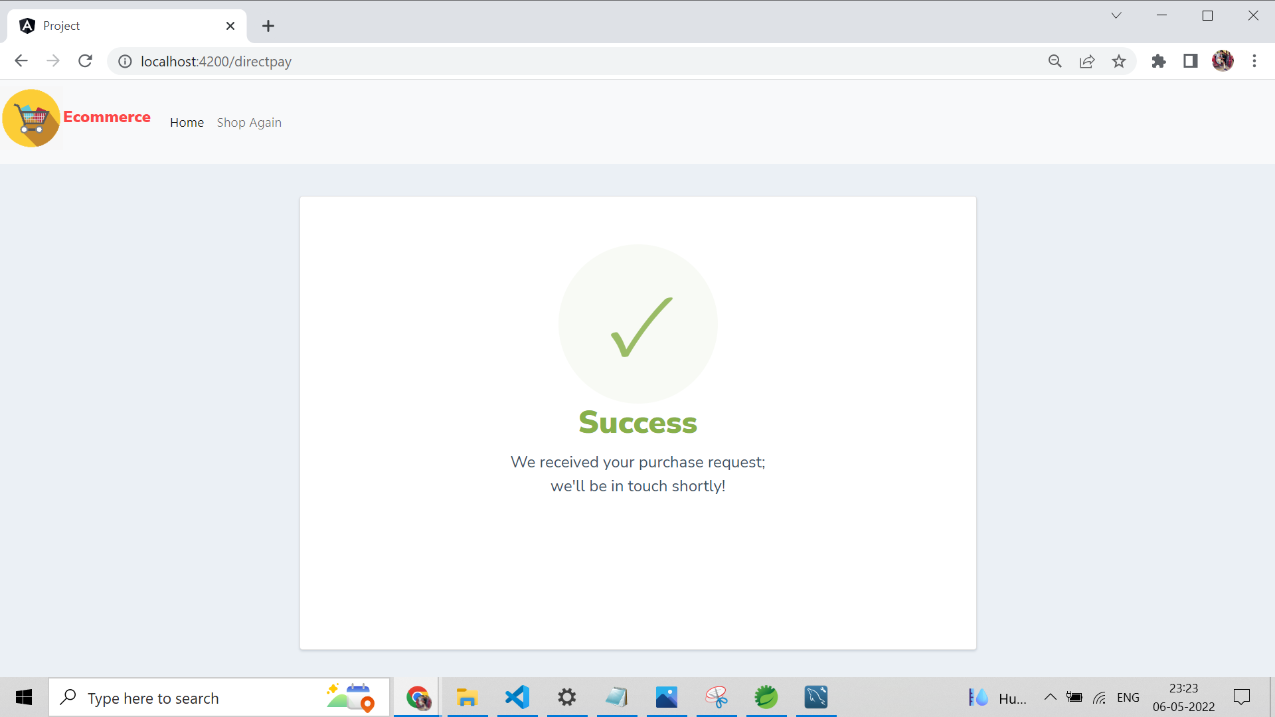
Payment success

Slide 21

Conclusion
Technology has made significant progress over the years to provide consumers a better online shopping experience and will continue to do so for years to come.
With the rapid growth of products and brands, people have speculated that online shopping will overtake in-store shopping.
While this has been the case in some areas, there is still demand for brick and mortar stores in market areas where the consumer feels more comfortable seeing and touching the product being bought.
However, the availability of online shopping has produced a more educated consumer that can shop around with relative ease without having to spend a large amount of time.
In exchange, online shopping has opened up doors to many small retailers that would never be in business if they had to incur the high cost of owning a brick and mortar store.
At the end, it has been a win-win situation for both consumer and sellers.

Slide 22

rEFERENCE
WEBSITE
https://www.w3schools.com
https://www.javatpoint.com
www.baeldung.com
http://marco.dev
http://mvnrepository.com
YOUTUBE CHANNEL
Java Guides
Let’s Program

